Slide 1

ADVANCED NETWORK
BRIDGING TECHNOLOGIES
TRILL • Provider Bridging (Q-in-Q) • Provider Backbone Bridging (MAC-in-MAC)
A Comprehensive Two-Hour Lecture
Network Architecture and Data Center Technologies • February 2026

Slide 2






LECTURE OUTLINE AND TIME ALLOCATION
This two-hour lecture is divided into seven major modules, each building upon the previous to provide a comprehensive understanding of Layer 2 bridging technologies.
1
Overlay Networks
20 min
0:00–0:20
2
Foundations and the Problem Space
20 min
0:00–0:20
3
TRILL — Transparent Interconnection of Lots of Links
25 min
0:20–0:45
4
Provider Bridging (802.1ad / Q-in-Q)
20 min
0:45–1:05
5
Provider Backbone Bridging (802.1ah / MAC-in-MAC)
20 min
1:05–1:25
6
Comparative Analysis and Decision Framework
25 min
1:25–1:50
7
Case Studies, Summary, and Q&A
10 min
1:50–2:00

Slide 3
MODULE 1
Datacenter Overlays
Why STP falls short and what came next • 0:00–0:20

Slide 4
DATA CENTER OVERLAY NETWORK CLASSIFICATION
Overlay networks can be classified into two categories based on where encapsulation occurs:
NETWORK-BASED OVERLAYS
HOST-BASED OVERLAYS
Virtual Extensible LAN (VXLAN)
Network Virtualization using GRE (NVGRE)
Stateless Transport Tunneling (STT)
TRILL
IEEE 802.1ad Provider Bridge (Q-in-Q)
IEEE 802.1ah Provider Backbone Bridge (PBB)
Cisco FabricPath
Overlay Transport Virtualization (OTV)
Location/ID Separation Protocol (LISP)
Multiprotocol Label Switching (MPLS)
Encapsulation at network switches/routers
Encapsulation at hypervisor / virtual switch

Slide 5
MODULE 1
Foundations &
the Problem Space
Why STP falls short and what came next • 0:00–0:20

Slide 6
1.1 REVIEW OF LAYER 2 BRIDGING FUNDAMENTALS
The Ethernet Bridge Model
Ethernet bridging, standardized in IEEE 802.1D, provides transparent frame forwarding at Layer 2. A bridge learns MAC addresses from source address fields of incoming frames and forwards frames to the port associated with the destination MAC address. When the destination is unknown, the bridge floods the frame to all ports except the ingress port. This learn-and-forward model is the basis for all modern switching.
Spanning Tree Protocol and Its Limitations
The Spanning Tree Protocol (STP, IEEE 802.1D) was designed to prevent broadcast storms and loops in bridged networks. STP works by electing a root bridge and placing redundant ports in a blocking state, creating a loop-free tree topology. Critical limitations:
Inefficient bandwidth utilization: blocked links carry no traffic, wasting up to 50% of available capacity
Slow convergence: original STP can take 30–50 seconds to reconverge after a topology change
Single-path forwarding: all traffic follows the same spanning tree, preventing optimal path selection
VLAN scalability limits: standard 802.1Q supports a maximum of 4,094 VLANs
Flat MAC address tables: large Layer 2 domains require switches to learn enormous MAC tables

Slide 7
1.2 THE THREE TECHNOLOGIES AT A GLANCE
The limitations of STP become particularly acute in large-scale data centers and service provider metro Ethernet networks.
TRILL (RFC 6325, IETF)
Replaces STP in data center and campus environments by running a link-state routing protocol (IS-IS) at Layer 2. TRILL enables multipath forwarding, eliminates blocked links, and provides fast convergence.
Provider Bridging (IEEE 802.1ad, Q-in-Q)
Extends the 802.1Q VLAN tag by adding a second, outer tag called the Service VLAN (S-VLAN). This allows service providers to transport customer VLAN traffic while keeping customer VLAN spaces isolated.
Provider Backbone Bridging (IEEE 802.1ah, MAC-in-MAC)
Encapsulates the entire customer Ethernet frame inside a new backbone MAC header. This completely isolates customer MAC addresses from the provider backbone.

Slide 8

MODULE 2
TRILL — Transparent
Interconnection of Lots of Links
IETF RFC 6325 • IS-IS at Layer 2 • Equal-Cost Multipath • 0:20–0:45

Slide 9
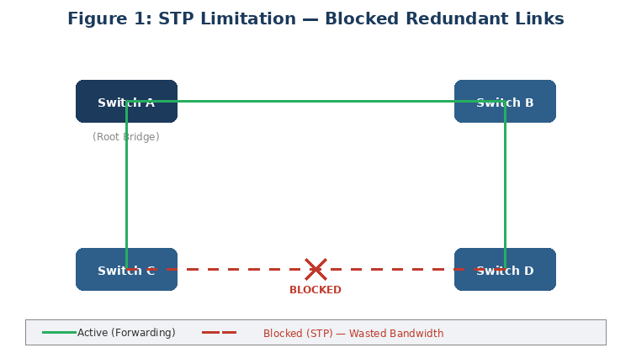
STP LIMITATION — BLOCKED REDUNDANT LINKS
50%
bandwidth wasted
by blocked links
30–50s
convergence time
after topology change
4,094
maximum VLANs
(802.1Q limit)
STP blocks redundant links, wastes bandwidth, and converges slowly — driving the need for advanced technologies.

Slide 10
2.1 TRILL OVERVIEW AND MOTIVATION
TRILL, standardized in IETF RFC 6325 (published in 2011), was designed to solve the fundamental problems of the Spanning Tree Protocol in large Layer 2 networks, particularly data centers. The key motivations include:
Eliminating the need for STP and its inherent waste of blocked links
Enabling Equal-Cost Multipath (ECMP) routing at Layer 2 for better bandwidth utilization
Achieving sub-second convergence upon link or node failure
Supporting large-scale data center fabrics with potentially thousands of switches
Maintaining backward compatibility with existing 802.1Q VLANs and Ethernet end stations

Slide 11
2.2 RBRIDGES (ROUTING BRIDGES)
The fundamental device in a TRILL network is the RBridge (Routing Bridge). An RBridge runs the IS-IS link-state routing protocol adapted for Layer 2. Each RBridge is assigned a unique 16-bit nickname used for forwarding decisions. RBridges operate in three roles:
Ingress RBridge: The first RBridge to receive a native Ethernet frame. It encapsulates the frame in a TRILL header before forwarding it into the TRILL campus.
Egress RBridge: The last RBridge in the TRILL path. It decapsulates the TRILL header and delivers the native Ethernet frame to the destination.
Transit RBridge: An intermediate RBridge that forwards TRILL-encapsulated frames based on the TRILL header, without examining the inner Ethernet frame.

Slide 12
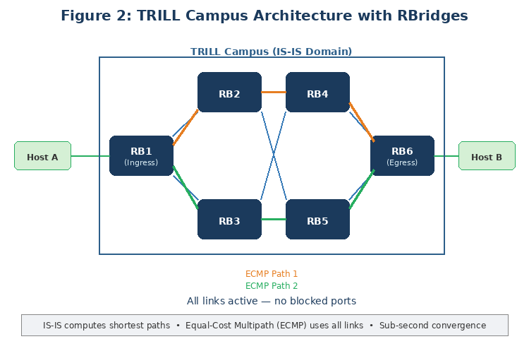
TRILL CAMPUS ARCHITECTURE

Slide 13
TRILL HEADER FORMAT AND ENCAPSULATION STACK
TRILL Header Fields
Encapsulation Stack
1. Outer Ethernet Header (outer MACs, EtherType 0x22F3)
Version (V): 2 bits, currently set to 0
Multi-destination (M): 1 bit, set to 1 for broadcast/multicast/unknown unicast frames
Hop Count: 6 bits, decremented at each transit RBridge to prevent infinite loops
Egress RBridge Nickname: 16 bits, identifies the destination RBridge
Ingress RBridge Nickname: 16 bits, identifies the source RBridge
2. TRILL Header (ingress/egress nickname, hop count, M-bit)
3. Inner Ethernet Header (original source/dest MACs)
4. Inner VLAN Tag (original 802.1Q tag if present)
5. Original Payload (IP packet, ARP, etc.)

Slide 14
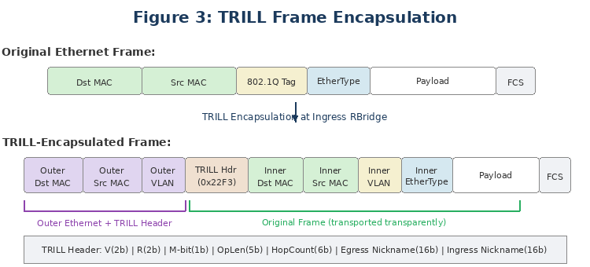
TRILL FRAME ENCAPSULATION FORMAT
Hop Count prevents loops • 16-bit Nicknames identify RBridges • M-bit flags multi-destination frames

Slide 15
2.3 CONTROL PLANE: IS-IS FOR TRILL
TRILL adapts the IS-IS routing protocol to operate at Layer 2. Each RBridge constructs a complete map of the TRILL campus topology by exchanging Link State Protocol Data Units (LSPs). From this database, each RBridge independently computes shortest-path trees for unicast forwarding and distribution trees for multi-destination frames.
Unicast Forwarding
For known unicast traffic, the ingress RBridge looks up the destination MAC address to determine the egress RBridge nickname, then consults the IS-IS-computed forwarding table for the next hop. If multiple equal-cost paths exist, TRILL supports ECMP load balancing using a hash of the inner frame headers to keep flows on consistent paths.
Multi-Destination Forwarding
Broadcast, multicast, and unknown unicast frames use distribution trees rooted at designated RBridges. The ingress RBridge sets the M-bit and specifies the tree root in the egress nickname field. Transit RBridges forward along the tree; egress RBridges decapsulate and deliver.

Slide 16


2.4 TRILL — ADVANTAGES AND LIMITATIONS
ADVANTAGES
LIMITATIONS
Proprietary competition: Cisco developed FabricPath, creating vendor lock-in concerns
Deployment complexity: requires IS-IS expertise
Not designed for WAN or service provider metro networks; targets data center and campus
Industry has largely shifted toward VXLAN and EVPN as the preferred solution
Limited multi-vendor interoperability in practice
Multipath forwarding with ECMP eliminates wasted bandwidth of STP blocked ports
Sub-second convergence due to link-state routing (vs. 30–50 seconds for classic STP)
Loop prevention through hop count decrement, independent of STP
Transparent to end stations: no changes required to hosts, VMs, or existing infrastructure
Fine-grained load balancing across multiple paths based on flow hashing

Slide 17
2.5 TRILL DEPLOYMENT SCENARIOS
Large Data Center Fabrics
Where east-west traffic dominates and multipath forwarding is essential for performance.
Campus Core Networks
Where redundant links exist and STP-blocked ports waste bandwidth.
VM Mobility Domains
Where VMs must migrate across a large Layer 2 domain without changing IP addresses.
Note: VXLAN with EVPN has become the dominant approach for new data center overlay networking deployments.

Slide 18
THE CASE FOR LAYER 2 IN MODERN DATA CENTERS
There is a school of thought that having Layer 3 at the access switches can resolve most MSDC requirements. But Layer 2 has a fundamental advantage:
LAYER 2 ADVANTAGES
LAYER 3 ADVANTAGES
Eliminates the need for STP entirely
Equal-cost multipath (ECMP) between any two switches
All links forward traffic — better load balancing
Hierarchical IP addressing enables efficient summarization
Better use of switch table resources vs. flat MACs
Plug-and-play — no interface IP configuration needed
Administration of VLANs is straightforward
MAC learning is automatic, including STP state
Hosts/VMs can be moved freely wherever the VLAN exists
Extremely useful for virtual machine mobility
L3 Drawback:
Not plug-and-play — requires IP assignment, routing protocol configuration, and more expertise to maintain.
What is needed: a network combining L2 plug-and-play with L3 efficiency — this is exactly what TRILL delivers.

Slide 19
TRILL ADDRESSING — NICKNAMES
Every RBridge is identified by a nickname — the addressable entity in a TRILL network, analogous to an IP address in Layer 3. Unlike IPv4, every interface does not need a nickname — one per RBridge is sufficient.
Nickname Properties
Nicknames are 16-bit flat addresses (like Ethernet MACs). Location of every RBridge/nickname is distributed by IS-IS to compute routes, just as in Layer 3 routing.
Automatic Assignment
When an RBridge boots, it receives info about all other RBridges and their nicknames, then randomly picks a unique 16-bit nickname. Collision detection and manual override are supported.
Forwarding Analogy
Ingress and egress nicknames in TRILL are equivalent to source and destination IP addresses. The forwarding table maps nicknames to next hops, just like an IP routing table.

Slide 20
TRILL DATA PLANE — FORWARDING BEHAVIOR
RBridge forwarding is a combination of bridging and routing functionality:
When a native frame arrives at an ingress RBridge, lookup uses <VLAN, DMAC> — just like a regular L2 bridge
Regular SMAC learning occurs based on <SMAC, VLAN> against the incoming port
For a regular bridge, the result would be an outgoing port — for TRILL, it's the egress RBridge nickname
The frame is encapsulated: Outer SMAC/DMAC are set to this RBridge and next-hop RBridge MACs
At each transit hop, only the outer MAC header is rewritten — inner frame is never examined
At the egress RBridge, the TRILL header is stripped and the original CE frame continues on the CE network
MAC Address Learning in TRILL
In TRILL, <end host MAC, VLAN> are learned by associating them with the ingress RBridge nickname (not the port). Core RBridges do NOT need to learn end-host MACs — only edge RBridges do. The ESADI protocol (End System Address Distribution Information) can distribute end-host MACs via IS-IS TLVs, reducing flooding.

Slide 21
TRILL DATA PLANE — FORWARDING BEHAVIOR
WATCH TRILL SIMULATION

Slide 22

DEEP DIVE
Cisco FabricPath
TRILL in Practice
Cisco's implementation of TRILL • NX-OS • Hierarchical MACs • Conversational Learning

Slide 23
CISCO FABRICPATH — OVERVIEW
Cisco FabricPath is an innovation in NX-OS Software that brings the stability and scalability of routing to Layer 2. The switched domain does not have to be segmented, providing data center–wide workload mobility. Because traffic is no longer forwarded along a spanning tree, the bisectional bandwidth of the network is not limited.
FabricPath eliminates Spanning Tree Protocol in the core fabric
Uses extensions to IS-IS to exchange unicast and multicast reachability information
IS-IS is a dynamic link-state protocol — detects topology changes, calculates loop-free routes
IS-IS runs directly at Layer 2 — requires no IP configuration in the FabricPath domain
STP still runs at the Classic Ethernet (CE) edge for backward compatibility
FabricPath encapsulates the entire L2 frame with a new FabricPath header (MAC-in-MAC style)

Slide 24
FABRICPATH ENCAPSULATION AND SWITCH ID
FabricPath switching encapsulates the entire Layer 2 frame with a new header. Each device is automatically assigned a unique Switch ID. The Outer Source Address (OSA) is the ingress switch ID; the Outer Destination Address (ODA) is the egress switch ID.
FabricPath Header Fields
ODA (egress switch ID), OSA (ingress switch ID), FTag (forwarding tag), TTL (hop count), FTAG EtherType. The LID is the address of the next interface (hop-by-hop).
Core Behavior
As the frame traverses the FP network, all devices work only with the FP header. FP interfaces work only with ODAs/OSAs — they never learn CE host MAC addresses.
Edge Behavior
When the frame egresses the FP network, the FP device strips the FP header and the original CE frame continues on the CE network unchanged.

Slide 25
FABRICPATH — MAC ADDRESS IMPROVEMENTS
FabricPath significantly reduces MAC table size and complexity through multiple mechanisms:
Conversational Learning at CE Edge
An interface learns a source MAC only if it already has a destination MAC for that conversation. Prevents learning MACs for one-way flows, dramatically reducing table size.
No CE MACs in FP Core
Core devices never need to know customer/end-host MAC addresses. They only work with FabricPath switch IDs.
Hierarchical MACs in Core
FP MAC addresses (OSA/ODA) are hierarchical — proportional to the number of FP switches, not end hosts. Results in much smaller MAC tables in the core.
IS-IS Discovery (No Timeout)
FP MAC addresses are discovered via IS-IS (not learned from data plane) and do not age out. This eliminates periodic re-flooding.
FabricPath separates addresses from location, allowing VMs to be moved freely across the fabric.

Slide 26

MODULE 3
Provider Bridging
IEEE 802.1ad / Q-in-Q
Double VLAN tagging • Customer isolation • Metro Ethernet • 0:45–1:05

Slide 27
3.1 PROVIDER BRIDGING OVERVIEW AND MOTIVATION
Provider Bridging, standardized in IEEE 802.1ad (2005, later folded into IEEE 802.1Q-2011), enables the transport of customer Ethernet traffic across a provider network while maintaining isolation. The technology is commonly known as Q-in-Q because it stacks one 802.1Q VLAN tag inside another.
VLAN space exhaustion: a single 802.1Q tag provides only 4,094 VLANs, insufficient for large providers
Customer VLAN isolation: customers may use overlapping VLAN IDs, requiring provider-level separation
Transparent Ethernet services: providers offer E-Line, E-LAN services where customer traffic is transported unchanged
Operational simplicity: straightforward tag-stacking requires minimal changes to existing equipment

Slide 28
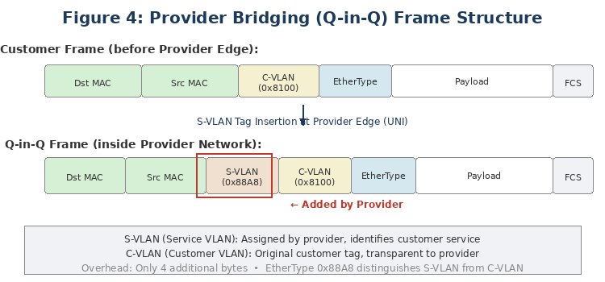
3.2 Q-IN-Q FRAME STRUCTURE
Provider Bridging adds a second VLAN tag, the Service VLAN (S-VLAN, EtherType 0x88A8), to the outside of the customer's existing C-VLAN tag (EtherType 0x8100).

Slide 29
MEF SERVICE TYPES
E-Line (Point-to-Point)
A dedicated S-VLAN connects two customer sites, providing a virtual Ethernet leased line.
E-LAN (Multipoint-to-Multipoint)
A single S-VLAN connects multiple customer sites with full any-to-any connectivity.
E-Tree (Rooted Multipoint)
Leaf sites communicate with root sites but not directly with each other.

Slide 30
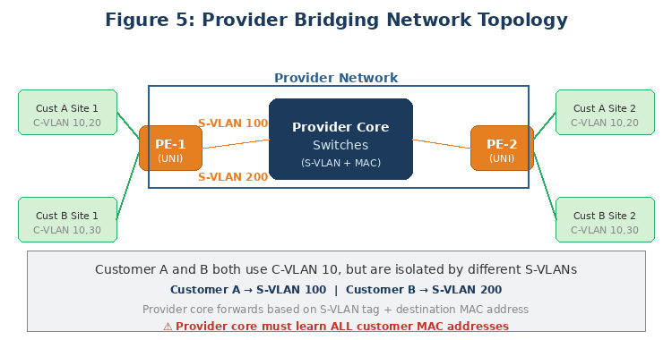
3.3 PROVIDER BRIDGE OPERATION

Slide 31
PROVIDER EDGE AND CORE OPERATIONS
At the Provider Edge (UNI)
At the User-Network Interface, the provider edge switch inserts S-VLAN tags. Common mapping strategies:
Port-based: All traffic from a physical port receives the same S-VLAN tag. Simplest and most common.
C-VLAN-based: Different customer VLANs map to different S-VLANs for service differentiation.
Combined: Port and VLAN-based mapping together for granular control.
Within the Provider Network
Inside the provider network, switches forward based only on the outer S-VLAN tag and destination MAC address. The C-VLAN tag is opaque to core switches. However, the provider network still learns customer MAC addresses, which creates scalability issues in large deployments.

Slide 32
3.4 PROVIDER BRIDGING — ADVANTAGES AND LIMITATIONS
ADVANTAGES
LIMITATIONS
MAC address scalability: provider core must learn all customer MAC addresses
STP dependency: provider network still relies on STP for loop prevention
Limited fault isolation: customer broadcast storms can affect the provider core
Security concerns: customer MAC addresses are visible to the provider backbone
Simple, well-understood technology based on standard VLAN tagging
Widely supported: nearly all enterprise and carrier switches support Q-in-Q
Expands VLAN space to ~16.7 million logical service instances (S-VLAN × C-VLAN)
Customer VLAN transparency: customers retain full control of their VLAN space
Minimal overhead: only 4 additional bytes per frame

Slide 33
3.5 PROVIDER BRIDGING DEPLOYMENT SCENARIOS
Metro Ethernet Services
Primary use case for provider Ethernet connectivity between customer sites.
Data Center Interconnect
Layer 2 extension between data centers within a metro area.
Wholesale Ethernet
Upstream providers offering transport to downstream operators.
Enterprise WAN
Segregating traffic from different departments or subsidiaries.

Slide 34

MODULE 4
Provider Backbone Bridging
IEEE 802.1ah / MAC-in-MAC
Complete MAC isolation • 24-bit I-SID • Backbone scalability • 1:05–1:25

Slide 35
4.1 PBB OVERVIEW AND MOTIVATION
Provider Backbone Bridging (PBB), standardized in IEEE 802.1ah (2008), addresses the scalability limitations of Provider Bridging. PBB encapsulates the entire customer frame, including MAC addresses, inside a new backbone MAC header.
While Q-in-Q solved the VLAN scalability problem, it did not address MAC address scalability. PBB solves this by hiding customer MACs from the backbone entirely.

Slide 36
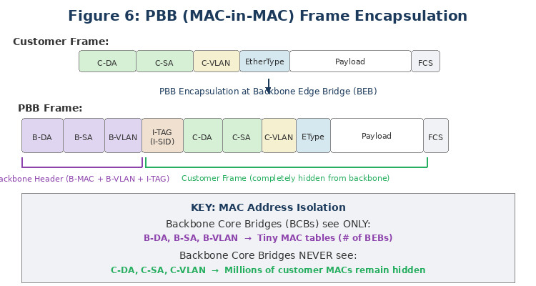
4.2 PBB MAC-IN-MAC ENCAPSULATION
PBB encapsulates the entire customer Ethernet frame inside a new backbone header with new source and destination MAC addresses belonging to the provider backbone.

Slide 37
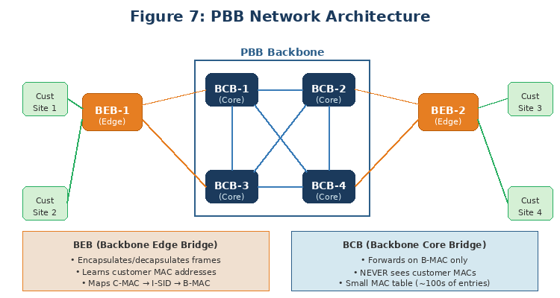
4.3 PBB NETWORK COMPONENTS

Slide 38
BEB/BCB ROLES AND FORWARDING
Backbone Edge Bridge (BEB)
Performs encapsulation/decapsulation. Maps customer frames to I-SIDs and backbone MAC headers. Learns customer MAC addresses per I-SID.
Backbone Core Bridge (BCB)
Forwards based only on backbone MACs (B-DA, B-SA) and B-VLAN tags. Never sees customer MAC addresses — the key to PBB scalability.
Control Plane and Forwarding
The BEB performs standard MAC learning on customer frames, associating customer MACs with I-SIDs and remote BEB backbone MACs. BCBs perform simple forwarding using only backbone MAC addresses. A backbone serving 10,000 customers with 1,000 MACs each requires only ~200 backbone MAC entries at the BCB, versus 10 million with Q-in-Q.

Slide 39
4.5 PBB-TE (TRAFFIC ENGINEERING)
PBB-TE (IEEE 802.1Qay) enhances PBB by replacing STP with explicitly provisioned, deterministic paths:
Connection-oriented forwarding with provisioned paths, similar to MPLS LSPs
Deterministic performance with guaranteed bandwidth and bounded latency
50 ms protection switching using pre-provisioned backup paths
Elimination of MAC learning and flooding in the backbone core
OAM capabilities compatible with IEEE 802.1ag Connectivity Fault Management

Slide 40
4.6 PBB — ADVANTAGES AND LIMITATIONS
ADVANTAGES
LIMITATIONS
Complete MAC address isolation: backbone never learns customer MACs
24-bit I-SID provides 16 million service instances
Simplified backbone with small MAC tables
Enhanced security: customer MACs invisible to the backbone
Compatible with PBB-TE for deterministic transport
Significant per-frame overhead: ~18 additional bytes
Increased complexity at the BEB
Less widespread vendor support than Q-in-Q
Competition from MPLS/VPLS and EVPN solutions
MTU considerations: requires larger MTU support throughout the backbone

Slide 41
4.7 PBB DEPLOYMENT SCENARIOS
Large-Scale Metro Ethernet
Thousands of customers with millions of MAC addresses.
Carrier Ethernet Backbones
Tier 1 and 2 providers, often with PBB-TE for traffic engineering.
Mobile Backhaul
Converged Ethernet backbone for LTE/5G cell site connectivity.
Utility/Transportation Networks
Mission-critical networks requiring PBB-TE deterministic performance.

Slide 42
PBB — INDUSTRY PERSPECTIVE AND REMAINING CHALLENGES
From the cloud networking perspective: IEEE 802.1ah encapsulates end-user traffic in the provider's MAC address header, allowing the BEB to support large numbers of service instances while hiding customer MACs from the BCB.
Remaining Challenge:
In addition to IEEE 802.1ad capabilities, PBB hides customer MACs through MAC-in-MAC encapsulation. However, it faces challenges with features many provider networks want: multipathing, traffic engineering, and carrier-class resiliency — because it still relies on Spanning Tree Protocols for loop avoidance.
This is why PBB-TE (802.1Qay) was developed as an enhancement, and why the industry has increasingly turned to MPLS/EVPN which provides both multipathing and traffic engineering natively.

Slide 43

MODULE 5
Comparative Analysis &
Decision Framework
Side-by-side comparison • When to use each • 1:25–1:50

Slide 44
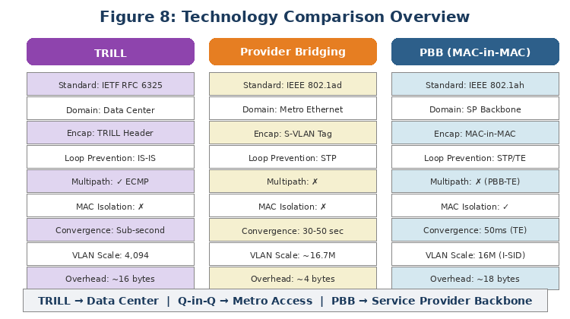
TECHNOLOGY COMPARISON OVERVIEW

Slide 45
5.1 SIDE-BY-SIDE COMPARISON
Feature | TRILL | Provider Bridging (Q-in-Q) | PBB (MAC-in-MAC)
Standard | IETF (RFC 6325+) | IEEE 802.1ad | IEEE 802.1ah
Primary Domain | Data Center / Campus | SP Metro Ethernet | SP Backbone
Encapsulation | TRILL hdr + outer Ethernet | Outer S-VLAN tag (Q-in-Q) | Full MAC-in-MAC header
Loop Prevention | IS-IS + Hop Count | Spanning Tree Protocol | STP (or PBB-TE)
Multipath | Yes (ECMP via IS-IS) | No (STP single path) | No (unless PBB-TE)
Convergence | Sub-second | 30–50 sec (classic STP) | 30–50s / 50ms (PBB-TE)
MAC Scalability | Same as traditional | Poor (cust MACs in backbone) | Excellent (MACs hidden)
VLAN Scalability | 4,094 (802.1Q) | ~16.7M (S×C VLAN) | 16M (24-bit I-SID)
Per-Frame Overhead | ~16 bytes | ~4 bytes | ~18 bytes
Control Plane | IS-IS link-state | STP / MSTP | STP or PBB-TE
Cust MAC Visibility | Visible end-to-end | Visible in provider core | Hidden from backbone
Vendor Support | Limited | Universal | Selected vendors
Industry Status | Declining (VXLAN/EVPN) | Widely deployed | Niche (MPLS/EVPN)

Slide 46
5.2 WHEN TO USE EACH TECHNOLOGY
Choose TRILL When:
Choose Q-in-Q When:
Choose PBB When:
Large provider needing backbone MAC scalability
Customer MAC isolation and security are critical
Deterministic, connection-oriented forwarding (PBB-TE)
Backbone must scale without exponential MAC growth
You need multipath Layer 2 forwarding in a data center or campus
STP convergence time is unacceptable
Dense switch interconnections and you want to use all bandwidth
Your vendor supports TRILL or a TRILL-derived fabric
Offering Metro Ethernet services to moderate customer count
MAC address scale is manageable (thousands, not millions)
You need simplicity, low overhead, universal vendor support
Multi-vendor interoperability is essential
Consider VXLAN/EVPN for new deployments
Ideal for <1K customers
Consider MPLS/EVPN for new backbone

Slide 47
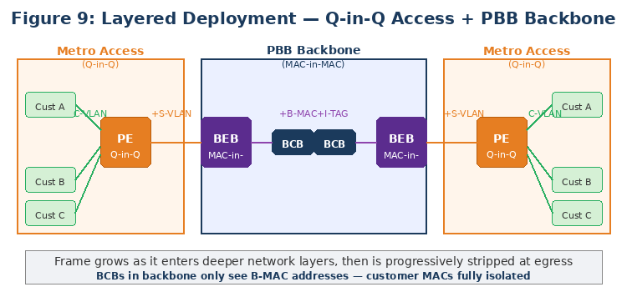
5.3 LAYERED AND COMBINED DEPLOYMENTS

Slide 48
LAYERED DEPLOYMENT DETAILS
These technologies can be layered or combined in architectures:
PBB over Provider Bridging: Customer traffic is tagged with S-VLANs at the metro edge, then encapsulated in PBB backbone headers for core transport. This creates a natural hierarchy: Q-in-Q at access, PBB at backbone.
PBB-EVPN (RFC 7623): Combines PBB MAC-in-MAC data plane with BGP-based EVPN control plane. Provides MAC scalability benefits of PBB with advanced EVPN control plane capabilities.
TRILL within PBB: Could theoretically replace STP in a PBB backbone for multipath core forwarding, but has seen limited practical deployment.

Slide 49
5.4 ARCHITECTURAL PHILOSOPHY COMPARISON
TRILL — Routing at Layer 2
Brings Layer 3 routing intelligence (link-state routing, shortest-path computation, multipath) down to Layer 2. Makes bridges routing-aware while remaining transparent to end stations.
Provider Bridging — Service Tagging
Incremental extension of existing VLAN tagging. The network's forwarding model remains unchanged (learn-and-forward with STP). A conservative approach that minimizes change while solving VLAN isolation.
PBB — Hierarchical Encapsulation
Creates a clean separation between customer and backbone domains. The backbone operates independently of customer addressing. Classic networking principle of layered abstraction applied to Ethernet.

Slide 50
5.5 DECISION FRAMEWORK SUMMARY
Requirement | TRILL | Q-in-Q | PBB
Data Center Fabric | ✓ Recommended* | ✗ Not designed for this | ✗ Not designed for this
Metro Ethernet Access | ✗ Wrong scope | ✓ Recommended | ✗ Overkill
Metro Ethernet Backbone | ✗ Wrong scope | ✗ Limited scalability | ✓ Recommended
Small Provider (<1K cust) | ✗ Unnecessary | ✓ Ideal | ✗ Unnecessary
Large Provider (>10K cust) | ✗ Wrong scope | ✗ MAC scale issues | ✓ Ideal
Multipath Requirement | ✓ Core capability | ✗ Not supported | ✗ Requires PBB-TE
Sub-second Failover | ✓ Core capability | ✗ STP limited | ✓ With PBB-TE
MAC Address Isolation | ✗ Not provided | ✗ Not provided | ✓ Core capability
Minimal Frame Overhead | ✗ ~16 bytes | ✓ ~4 bytes | ✗ ~18 bytes
Multi-vendor Interop | ✗ Limited | ✓ Universal | ○ Moderate
* For new data center deployments, VXLAN/EVPN is generally preferred over TRILL.

Slide 51
MODULE 6
Case Studies, Summary
& Q&A
Real-world deployment examples • Key takeaways • 1:50–2:00

Slide 52
6.1 CASE STUDY 1: REGIONAL METRO ETHERNET PROVIDER
A regional service provider with 2,000 business customers across a metropolitan area needed to offer Ethernet connectivity services. Each customer required 1–10 VLANs.
Challenge: Standard 802.1Q VLANs were insufficient, and customer VLAN ranges overlapped.
Solution: Provider Bridging (Q-in-Q). Each customer assigned a unique S-VLAN. Total MAC count ~50,000.
Outcome: Rapid deployment with existing equipment, full customer isolation, familiar management tools.

Slide 53
6.2 CASE STUDY 2: NATIONAL CARRIER ETHERNET BACKBONE
A Tier 1 national carrier needed to transport Ethernet from 50,000+ customer sites across 100+ PoPs.
Challenge: Customer MAC count exceeded 5 million, overwhelming backbone switch tables.
Solution: PBB (802.1ah) at backbone core with Q-in-Q (802.1ad) at metro edge. BCBs maintain only ~200 backbone MAC entries.
Outcome: Stable, small MAC tables. Complete customer isolation. Simplified service provisioning via I-SID.

Slide 54
6.3 CASE STUDY 3: LARGE ENTERPRISE DATA CENTER
A large enterprise with 5,000 servers hosting 50,000 VMs in a multi-tier switching fabric.
Challenge: STP blocked 40% of bandwidth. VM migration needed Layer 2 adjacency. 30+ second convergence unacceptable.
Solution: TRILL deployment across the fabric. All switches replaced with RBridge-capable equipment running IS-IS.
Outcome: Bandwidth doubled (60% to ~100% utilization). Seamless VM migration. Sub-second failure recovery.

Slide 55
6.4 LECTURE SUMMARY
This lecture has covered three critical Layer 2 bridging technologies, each addressing distinct challenges:
TRILL brings routing intelligence to Layer 2, enabling multipath forwarding and fast convergence in data center and campus networks. It makes bridges smarter.
Provider Bridging (Q-in-Q) extends VLAN tagging with a simple, incremental approach to customer isolation in metro networks. It represents practical, minimal change.
Provider Backbone Bridging (MAC-in-MAC) introduces hierarchical encapsulation for massive scalability by hiding customer MACs from the backbone. It represents clean architectural separation.
While all three continue to have deployments, the industry has increasingly moved toward overlay technologies (VXLAN) with modern control planes (EVPN) that combine many of the best ideas from these technologies.

Slide 56
KEY TAKEAWAYS
1
No single technology addresses all Layer 2 challenges; the right choice depends on deployment domain and scale.
2
MAC address scalability is often the overlooked bottleneck; PBB directly addresses this while TRILL and Q-in-Q do not.
3
Multipath forwarding is essential for efficiency; TRILL pioneered this at Layer 2, and the concept lives on in ECMP-based IP fabrics.
4
These technologies can be layered (Q-in-Q at access, PBB at backbone) for comprehensive, scalable architecture.
5
Always evaluate against modern alternatives (VXLAN, EVPN, SR-MPLS) before committing to a technology for new deployments.

Slide 57
— END OF LECTURE —
Thank you — Questions?

